Slide 1
Zaf Roof Cleaning Website Development
Joseph Belachew

Slide 2
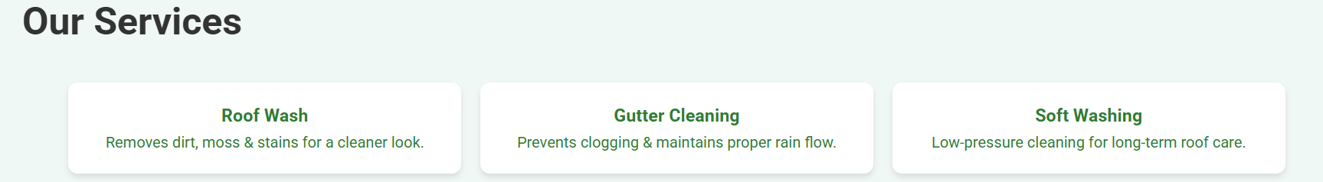
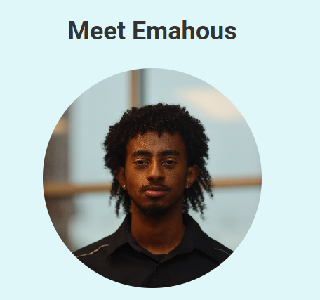
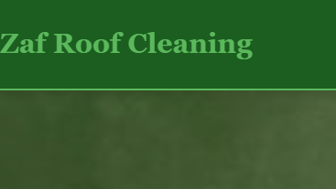
Home Page
Appearance- Made sure to incorporate Zaf Roof Cleaning at the top left to establish company name
Put introductory photo of you with some of the values you shared
Highlighted the three core services you offer.

Slide 3
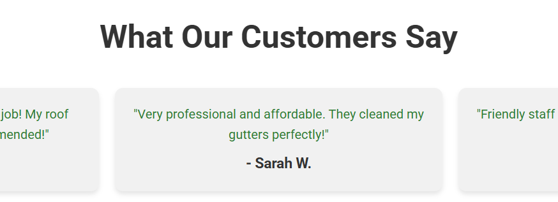
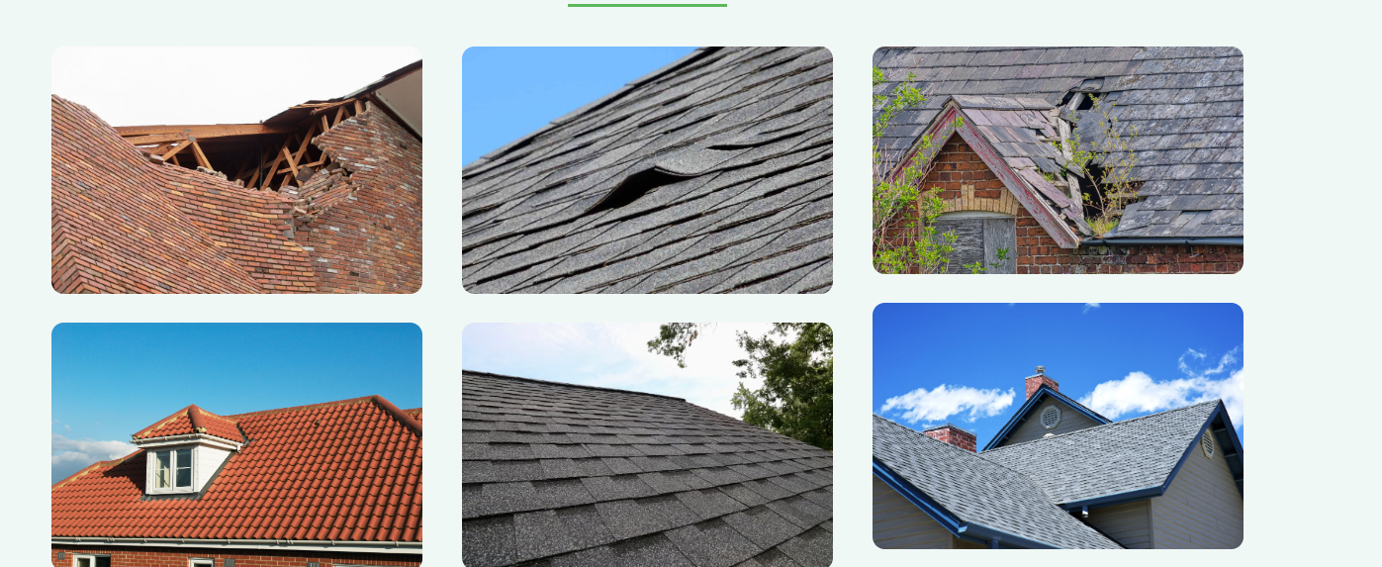
Home
Detail what each cleaning process does– Provided a clear format of what each thing you do is. For example, Gutter Cleaning prevents clogging
Showcased Before-and-After Photos which is Highlighting the transformation and effectiveness of the service
Include Customer Testimonials – Feature feedback from satisfied clients to build trust and credibility.

Slide 4
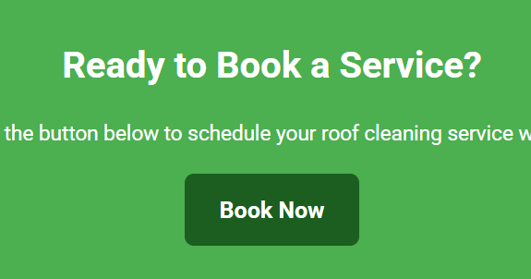

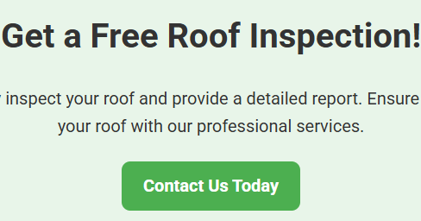
Home
Get a free inspection with a contact us today
Booking option early- Did this so customers can find it fast, so they don’t leave the page
Navigation system- It’s user friendly, basic and easy for everyone to read and browse

Slide 5
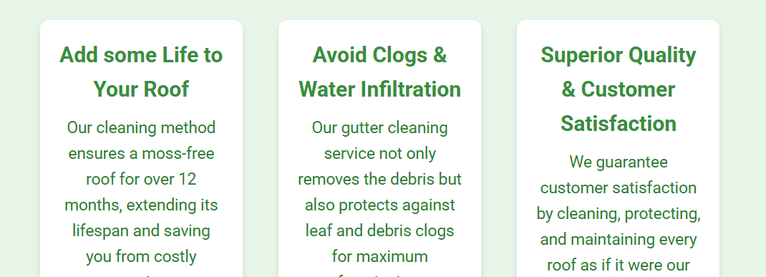
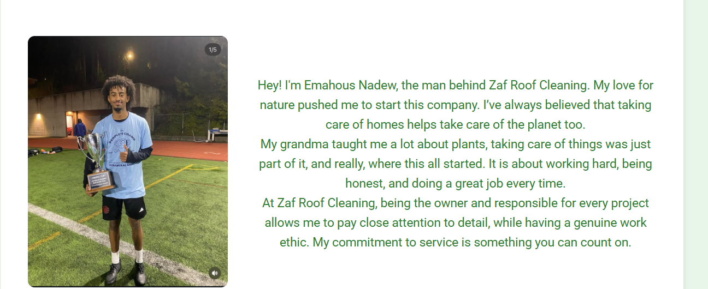
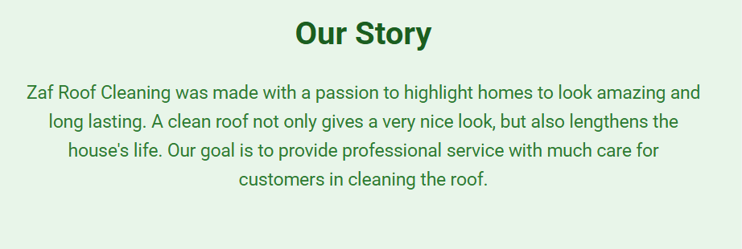
About
Tells the Story of Zaf – Showcases the journey and vision behind the brand
Provides a Deeper Insight into You – Highlights your experience, values, and expertise
Includes a "Why Zaf" Section – Explains what sets you apart and why customers should choose your services.

Slide 6
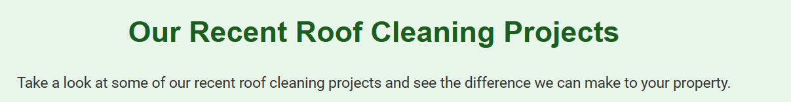
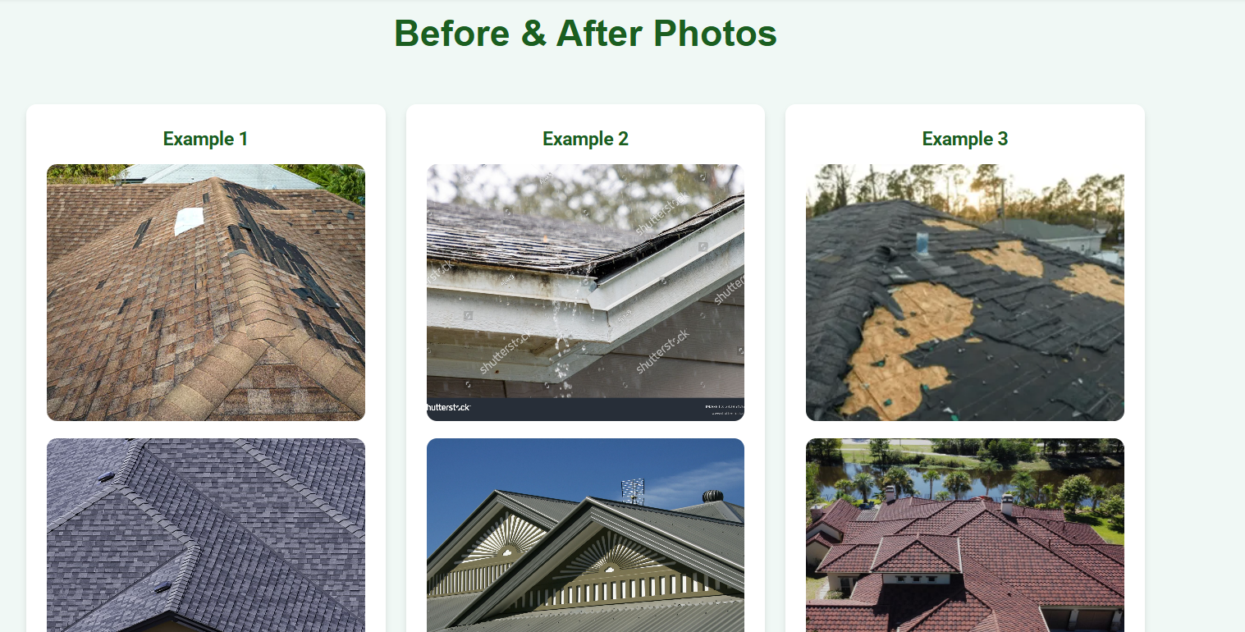
Gallery
Showcases Before-and-After Projects – Highlights successful transformations with visual comparisons.
Features Most Recent Work– Doing this allows customers to see what you have done lately

Slide 7
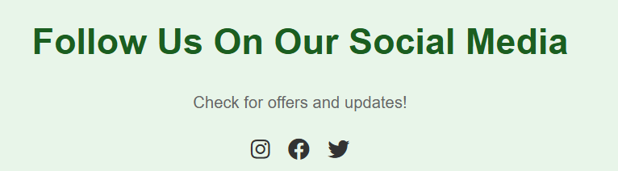
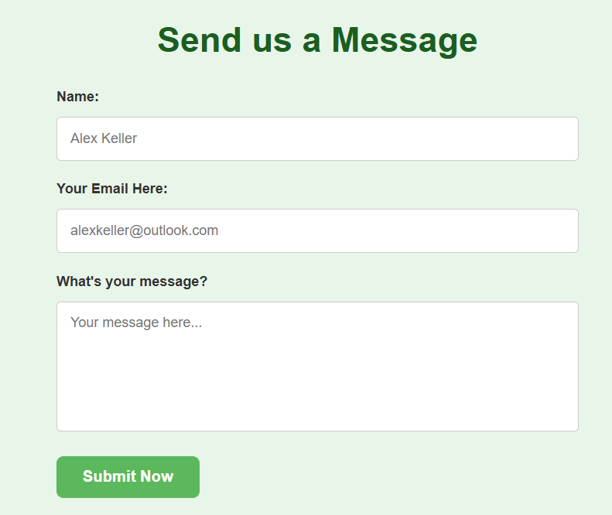
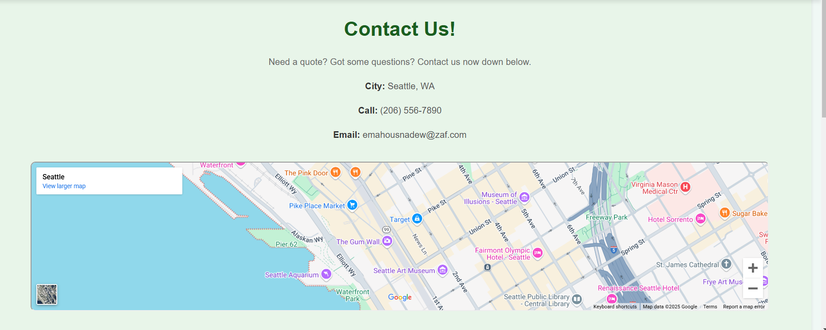
Contact Page
Displays Your Location – Helps customers easily see the areas you serve
Direct Messaging Feature – Messages sent go straight to your Zaf email for quick responses
Social Media – Links will be added as soon as your social accounts are done

Slide 8
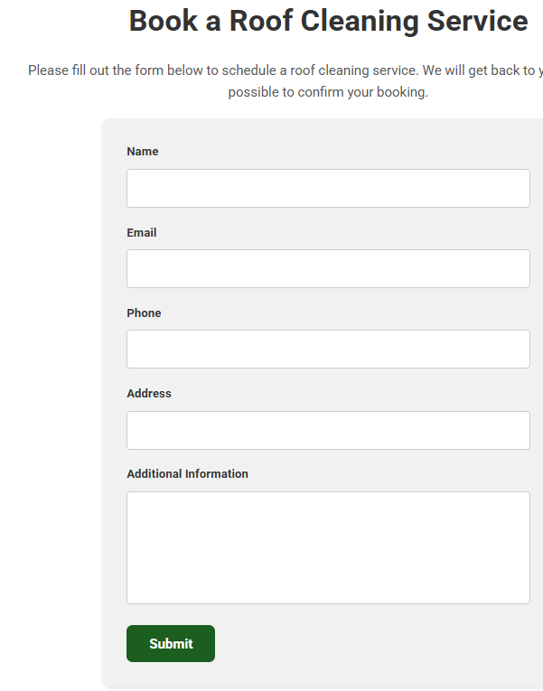
Booking
Automated Email Confirmation – Customers receive an email notification stating you'll respond within 2 days
It’s more of a flexible Scheduling Approach. Since you work part-time, this allows for flexibility without fixed time slots, giving you more control over your availability.

Slide 9
Demo
file:///C:/Users/Jbela_x/Desktop/Popcorn/index.html

